Slide 1

Communicating: Ensuring Vision Integrity through Effective Communication
2017/2018 Webinar Series
Presenter: Angela Irwin
President
AirWin Educational Services, LLC

Slide 2
Communicating: Ensuring Vision Integrity through Effective Communication
Effective Communication Defined
What Does It Mean to Communicate Effectively?
Effective communication is about sharing with the right people, the right information at the right time.
  Who are the right people?
  What is the right information?
  What is the right time for sharing information?

Slide 3
The Right People
Notes:
In Slide Show mode, click the arrow to enter the PowerPoint Getting Started Center.

Slide 4
Communicating: Ensuring Vision Integrity through Effective Communication
The Right People
“The single biggest problem in communicating is the illusion that it has taken place.”
George Bernard Shaw
Notes:
Print this for attendees

Slide 5
Communicating: Ensuring Vision Integrity through Effective Communication
The Right People: Primary and Secondary
Communications Network
SECONDARY
Vested Financial Entities
Community Partners
Local Press
Local Legislators
Local Law Enforcement
Local School District
Intermediate School District
Communications Network
PRIMARY
Authorizer
School Families
Michigan Department of Education
ESP
School Staff
Legal Counsel

Slide 6
Communicating: Ensuring Vision Integrity through Effective Communication
The Right People: To Whom Shall I Communicate?
Sample Communications Framework
What |  | Who |  | How |  | When
Topic/Issue | Purpose | Primary | Secondary | Spokesperson | Outlet | Timing
Student expulsion | d | a, b, c, d | f, g | a/c | b | ASAP
Always include general information about the Academy:
When opened
Authorizer
Location
Grades served
Student enrollment information/numbers
Management information
Charter contract status (e.g. when issued and term)
Notes:
October 2015 brief session with FSU – presented this slide (in a little different format) . . .

Slide 7
Communicating: Ensuring Vision Integrity through Effective Communication
The Right People: To Whom Shall I Communicate?
Legend:
Communications Purpose:
To ensure general awareness of . . . (specific topic)
To educate the general public on . . . (specific topic)
To demonstrate the Academy’s proactive approach in communicating with all stakeholders
To alleviate public concerns on critical issues
To highlight the Academy’s accomplishments, successes, positive events, etc.
Audiences:
Primary:
Authorizer
ESP
School staff
School families
Legal counsel
MDE
Secondary:
Vested financial entities
Community partners and associates
Local press
Local legislators
Local governmental agencies
Local school district
Intermediate school district
Spokesperson:
Board president
Academy leader/principal
Academy’s legal counsel
Management representative
Communications Outlet:
Press release
Written statements/letters/reports
Telephone conferences
Press conferences
Website
Other digital mediums/social networks
Notes:
October 2015 brief session with FSU – presented this slide (in a little different format) . . .

Slide 8
Communicating: Ensuring Vision Integrity through Effective Communication
The Right People: To Whom Shall I Communicate?
Communication Topics: Who Should Know?
Annexing existing facility
Changes in leadership at Academy
Adding a new staff position
Bomb threat at Academy
Hazing issue with student
Charter school closure
Exemplary State Assessment results
Authorizer
ESP
School Staff
School Families
Legal Counsel
Michigan Department of Education
Local Intermediate School District
Vested Financial Entities
Community Partners
Local Press
Local Legislators
Local Law Enforcement
Local School District
Notes:
October 2015 brief session with FSU – presented this slide (in a little different format) . . .

Slide 9
Communicating: Ensuring Vision Integrity through Effective Communication
The Right People
“The single biggest problem in communicating is the illusion that it has taken place.”
George Bernard Shaw
Notes:
Print this for attendees

Slide 10
The Right Information
Notes:
In Slide Show mode, click the arrow to enter the PowerPoint Getting Started Center.

Slide 11
Communicating: Ensuring Vision Integrity through Effective Communication
The Right Information: Structure
Inputs
(Academy Resources)
Outputs
(Delivery on Resources)
OUTCOMES
Impacts/changes based on effectiveness of inputs and outputs
Notes:
To get to the right information, we must first understand, structurally, the relationship between the Board and the ESP
FDIA has HIRED HHG to provide certain educational services as outlined in the executed management agreement; it is expected, then, that HHG will resource the academy with qualified people and quality “materials;” HHG is further expected to deliver on those resources = outputs; the Board, then, is generally interested in the outcomes/those changes/impact(s) based on the effectiveness of the inputs and outputs – the right information, then, for the Board is results – HHG should be reporting on results of their inputs and outputs; the authorizer, too, is interested in results . . . The Board should be interested in the inputs and outputs to the extent that they impact the outcomes/results . . . If the Academy is not producing the desired results, conversation, then, should center around the inputs/outputs; otherwise, inputs and outputs are the responsibility of HHG NOT the Board . . .
All of the impacted and interested parties I showed, previously, are interested in outcomes/results . . .

Slide 12



Communicating: Ensuring Vision Integrity through Effective Communication
The Right Information: Exchanging Questions
Board
ESP
Notes:
Wise Questions – print template and have available for reference (for me).

Slide 13

Communicating: Ensuring Vision Integrity through Effective Communication
The Right Information: The Charter Performance Contract
Standard legal documents:
  Terms and conditions
  Bylaws
  Articles of Incorporation
  Fiscal Agent Agreement
  Oversight Agreement
Accompanying schedules:
  Staff responsibilities – (Schedule 5)
  Physical plant description – (Schedule 6)
  Governance structure – (Schedule 7a)
  Educational goals and related measures – (Schedule 7b)
  Curriculum – (Schedule 7c)
  Methods of pupil assessment – (Schedule 7d)
  Admission policy and criteria – (Schedule 7e)
  Public Notice of Enrollment Procedures – (Schedule 7f)
  School calendar and day schedule – (Schedule 7g)
  Age and grade range of pupils – (Schedule 7h)
Notes:
All of these documents can be found within your charter performance contract; FSU’s contracts also contain some of FSU’s relevant “oversight” policies and resolutions and a Schedule 8 – Information available to public (see handout)

Slide 14
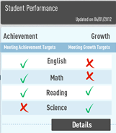
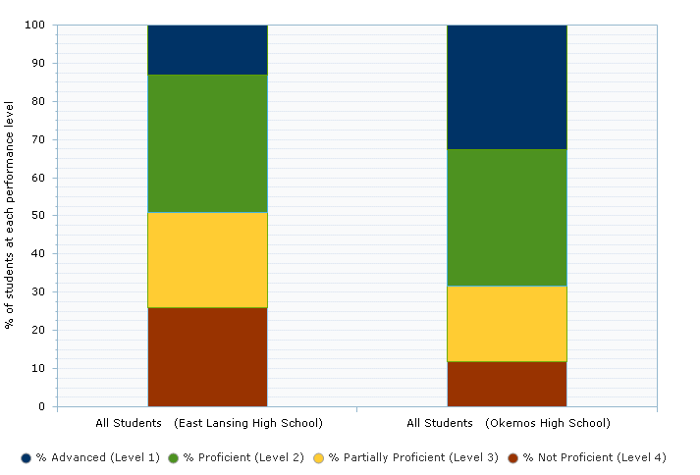
Communicating: Ensuring Vision Integrity through Effective Communication
The Right Information: School Academics
Achievement and Growth
Notes:
Three key components of getting to the right information . . . Academics, Fiscal Operations and Business Operations
Answers to wise questions surrounding these topics should be supported by accurate, relevant and “visual” detail – not too much, not too little . . .

Slide 15
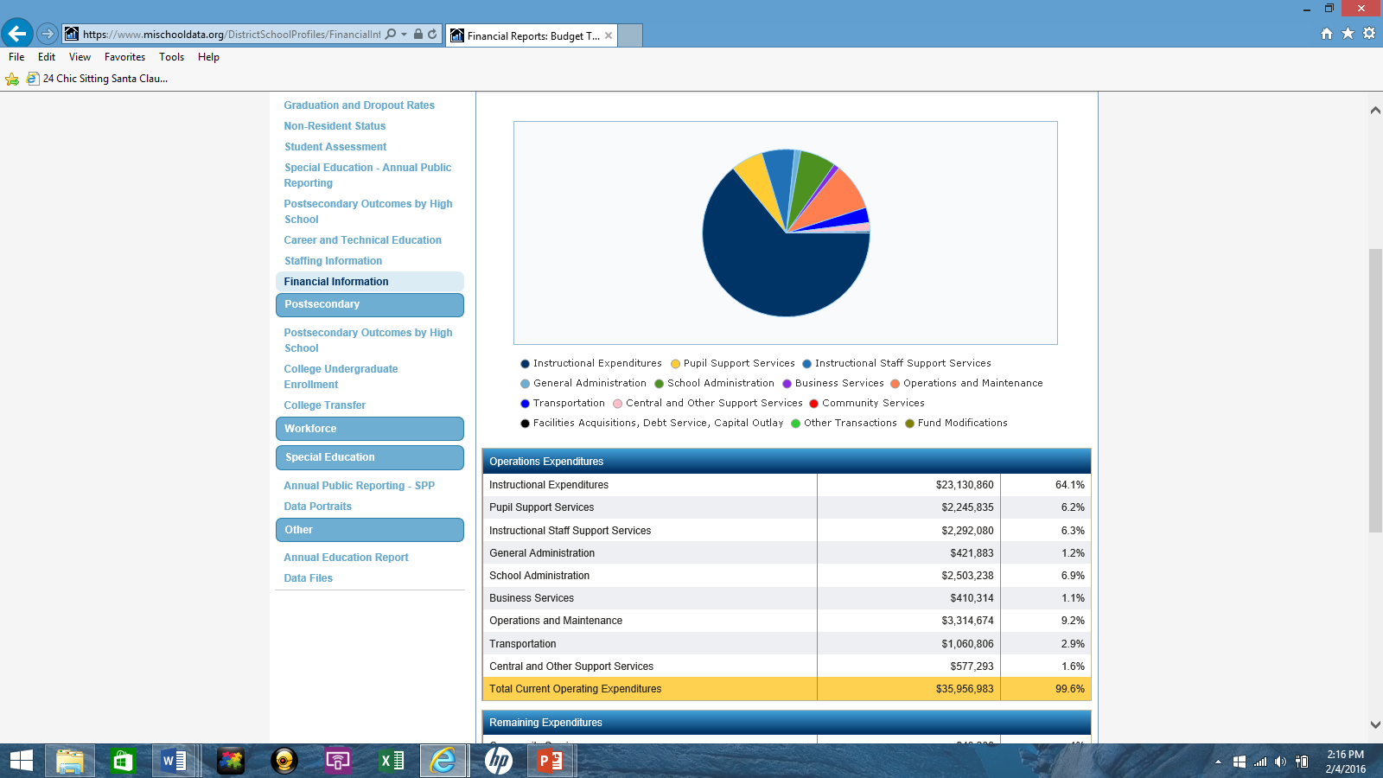
Communicating: Ensuring Vision Integrity through Effective Communication
The Right Information: Fiscal Operations
Financial Breakdowns

Slide 16
Communicating: Ensuring Vision Integrity through Effective Communication
The Right Information: Business Operations
Staff
Facilities
Educational Program
Technology
Food Service
Special Education
Extra Curricular Activities
Compliance Services
Inputs
(Academy Resources)
Outputs
(Delivery on Resources)
Management Agreement
Notes:
Business operations have both a fiscal and academic impact . . . While the Board has delegated the responsibility for operations to HHG, the Board has not abdicated its authority, as granted through the enabling legislation . . . while, as we discussed prior, the Board should not bog itself down in operational detail, it should have a sense of what is going into (resources) and coming out of the Academy (outputs) to the extent they the academics and finances are affected . . . The overall results of HHG’s performance can and should be addressed through a formal evaluation tool (refer to the one I provided in June)

Slide 17
The Right Time
Notes:
In Slide Show mode, click the arrow to enter the PowerPoint Getting Started Center.

Slide 18

Communicating: Ensuring Vision Integrity through Effective Communication
The Right Time

Slide 19
Communicating: Ensuring Vision Integrity through Effective Communication
The Right Time: Timing Considerations
General Timing “Events” for Discussion:
Student assessments (September/October (Fall); January/February (Winter); April/May (Spring – MAP and M-Step))
Application and enrollment period
Student enrollment counts and supplemental counts (1st Wednesday in October; 2nd Wednesday in February)
Board member candidate nomination(s)/authorizer governing board meetings
Annual Education Report (mid-October typical deadline for presentation to the public)
Financial information (by June 30th, budget adoption and public hearing on budget)

Slide 20
Communicating: Ensuring Vision Integrity through Effective Communication
The Right Time: Information Considerations
Standard Information: Shared and/or discussed:
  Board meetings
  Committee meetings
  Through standard communication protocol(s)

Slide 21
Communicating: Ensuring Vision Integrity through Effective Communication
The Right Time: Information Considerations
Urgent/Critical Information: Information that cannot wait for the next board meeting:
    Issues that compromise the health/safety of students and/or staff
    Issues that have the potential for impacting the charter contract (e.g. a missed testing window, a delayed building certificate of occupancy, building renovations/acquisitions, etc.)
    General issues or subjects with deadlines that are not conducive to meeting schedule
    Policy-related timing issues

Slide 22
Communicating: Ensuring Vision Integrity through Effective Communication
Mini Case Study
Introductory Stats:
Name of School: ABC Charter Academy
Grades Served: K-8
Location: Inner-city
Management Status: Managed – Full-Service Provider
Became Operational: 2012
Student Enrollment: 300
Board Composition: Five members, representing a cross-section of community professionals
Scenario:
As indicated above, ABC Charter Academy is a charter public inner-city school, serving grades K-8. The Academy became operational in 2012 (under a five-year contract) and has enjoyed stable, experienced leadership since its inception. Since 2012, other than standard start-up challenges, the Academy has operated “business as usual.” On October 5, 2016, ABC Academy Board President, Tom Jones, received telephone call from Academy leadership, Sally. Sally reported to Tom that, as she was talking, an incident involving multiple students was unfolding on Academy property. Specifically, Sally shared that a group of 10 students, five of which she could identify (two of which had IEPs), five she did not recognize, appeared to be engaged in a “drug deal.” Sally further indicated that she had called local law enforcement, who was “on their way,” but had not yet arrived. Sally was not sure if any of the students were carrying weapons but did see something that could have presented as a “glock” pistol. Sally has the school in a lock-down state.
Questions:
You are Board President Jones:
What is your immediate response to Sally?
Following your conversation with Sally, with whom do you communicate, immediately?
After communicating with all relevant parties, what is your next course of action?
What role does policy play in this issue?

Slide 23
Thank You!
Notes:
In Slide Show mode, click the arrow to enter the PowerPoint Getting Started Center.

