Slide 1
2019/2020 Webinar Series: Board Best Practices
Preparing, Reviewing and Managing the Agenda
October 14, 2019

Slide 2
The Goal:
Efficient and Effective Board Meetings

Slide 3
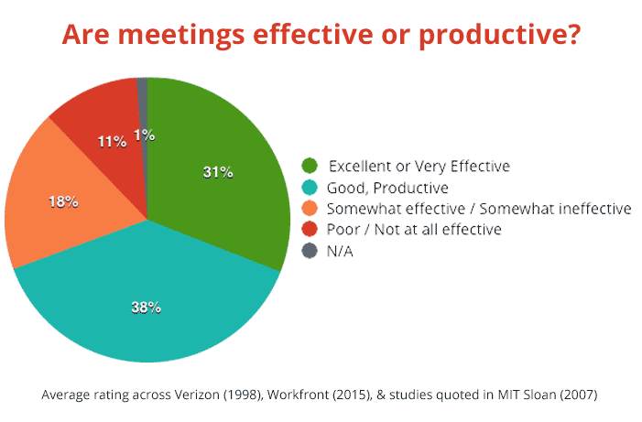
The Reality . . .

Slide 4
What Constitutes Effective AND Efficient Meetings?

Slide 5
Effective and Efficient Meetings Include:
Thoughtful agenda development
Comprehensive review of agenda and all board materials
Effective agenda management at board meeting

Slide 6
Thoughtful Agenda Development:
Find balance between “underloading” and “overloading” agenda
Keep agenda substantive
Develop agenda for meeting “sprints” not “marathons”
Formally track carry over agenda items
When/where and how to place special or “calendar” agenda topics (i.e. NWEA testing, student application and enrollment, annual meeting, budget hearing, closed sessions, etc.)

Slide 7
Comprehensive Review of Materials:
Be certain materials are being received well enough in advance
Develop/use agenda/materials review template
Review materials in accordance with board-adopted policy
Set procedure for routing questions about information to be discussed at meeting

Slide 8
Effective Agenda Management:
Not just the “job” of the board president
Set time limits per discussion/agenda item(s)
Know when to establish committee(s)
Use meetings to get questions answered and deliberate on policy matters

Slide 9
How Does Board Culture Impact Meeting Effectiveness and Efficiency?

Slide 10
“Board Culture has a Significant Influence on the way your Board Carries out its Work and Shapes your Board Performance.” BoardSource: https://boardsource.org/fundamental-topics-of-nonprofit-board-service/culture-dynamics /

Slide 11
Identify/Document Board Culture
Board Culture (Defined): Set of traditions and habits established over time that guide behavior
What are your Board’s cultural expectations?
How do those expectations translate to productive meetings?

Slide 12
Characteristics of a Strong Board Culture:
A healthy and respectful partnership between and among all stakeholders (i.e. board, leadership and authorizer)
Trust and candor between board members
Thoughtful and productive resolution of issues or disagreements
A willingness to address poor board behavior that is negatively impacting the board

Slide 13
Tying it All Together:
The goal is always to engage in BOTH effective and efficient meetings
Effectiveness and efficiency begins with thoughtful agenda preparation and concludes with effective agenda management
Board culture plays a significant role in yielding effective and efficient meetings

Slide 14
THANK YOU AND HAPPY FALL

