Slide 1
Presented by Julie Hopper, M.A. Education Academic Assessment Specialist

Slide 5
Notes:
21 ACT score or 1070 SAT

Slide 7
Notes:
Petoskey, Zeeland, Grand Rapids

Slide 14
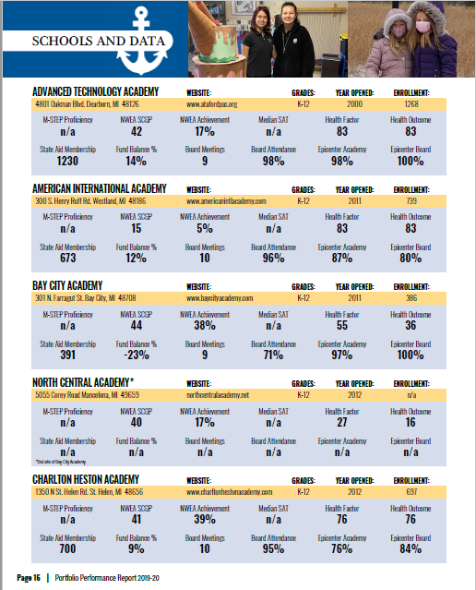

Slide 15
Community Health
Health Factors Ranking
Health Outcomes Ranking

Slide 16
Formula Health Behaviors + Clinical Care + Social/Economic Factors + Physical Environment= Length & Quality of Life

Slide 17
