Slide 1

Governing Beyond the School Year
Webinar Series: 2022/2023
Presented by: Angela L. Irwin, Owner
AirWin Educational Services, LLC
Presented by:
Angela Irwin, Owner
Notes:
Welcome participants – remind them that this is the last session in the series – what were your goals/attempting to accomplish this series?
Housekeeping issues, including survey completion

Slide 2
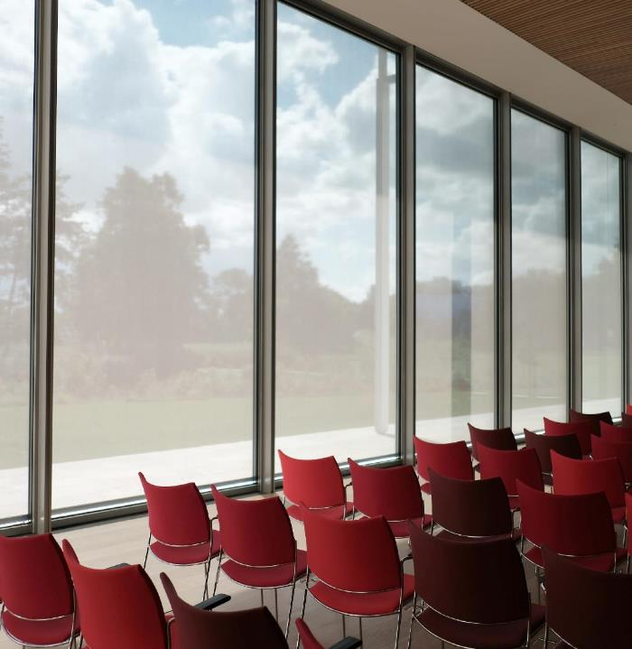
Recap of Webinar Series
2022/2023: The Art of Intentional Governance
Notes:
What’s new in 2022 (September) – Focus: school year/themed governance, monthly and wise questions
What’s to be in 2023 (October) – Red flags/adjustments/action plan – intentional discussion
Assessing your governance work (November/December) – Focus: self-evaluation checkpoint – how well is the board doing in effectuating its governance role (relative to its role, in general, and anything new implemented as a result of this series)
Governing Over the Unexpected (March?) – Focus: balancing the unexpected with the intentional – helpful tips on how to do that/think about that

Slide 3

Governance “Self-Care”
What can you work on during the summer months that will make you better governors in the fall?
Notes:
How are we going to be intentional about our summer governance work? I call this governance self-care – discuss how boards typically use their summers (i.e. strategic planning, evaluations, othr board professional development, etc.), not discrediting or minimizing that, at all – in the spirit of this series, want to offer thoughts on how to be a little more intentional and focused on your own PD for the summer and even into the school year . . .

Slide 4

How do you Know?
Notes:
How do you know what you need? If we were together, in-person, I would ask you for input on how, as a board, you currently determine your summer PD needs . . .in some ways, summer seems like a good time to focus on those areas I just mentioned – strategic planning, evaluations, etc. . . . I am going to propose, however, a more reflective way of making those determinations that will result in a documented professional development plan for the summer and, potentially, year, for the board . . .

Slide 5

1. Reflect on your “governance year”
2. Identify “gaps” in your governance skills/practices
3. Use the summer (and longer, if necessary) to bridge those gaps

Slide 6

Reflecting on Year | Identifying Gaps | Bridging Gaps
ON DECISION-MAKING: What key decisions did we make? Where did we struggle in our decision-making? Did we measure our decisions against the vision/mission/core values? | ON DECISION-MAKING: Why did we struggle? What caused our struggles? Did any other factors, other than vision/mission/core values, board policy, documented plans, etc., influence our decision-making, differently? Do we understand our role in coordination with the vision/mission/core values? | ON DECISION-MAKING: Developing a framework for decision-making Re-connecting our board work to the vision/mission/core values of the school over which we are governing Understanding how the vision/mission/core values, board policy, documented plans, etc., aid our decision-making
ON MEETINGS: Were we transparent, open, communicative in our board role throughout the year? Were we forced to cancel meetings due to quorum-related issues? Was our meeting time sufficient to accomplish our “work”? | ON MEETINGS: Do we need to re-define “transparency,” “openness,” and “communicative” as they relate to our board role/work? Is the full board committed to its role? Are we actively seeking board candidates? Do we have a documented board recruitment “plan?” Are we preparing ourselves, adequately, for our board meetings? Are we receiving all of the information we need in advance of our board meetings to ensure both effective and efficient meetings? | ON MEETINGS: The role of the board in meeting its transparency, openness and communications’ responsibilities Administering self-evaluations that address, honestly, the board’s full commitment to its role/work How to recruit, orientate and on-board new members How to develop and manage an effective meeting
ON “GENERAL” BOARD WORK: What brought the most confusion to our governance work? Did we honor our authorizer/board/ESP relationship? Did we establish and use committees effectively? | ON “GENERAL” BOARD WORK: What created/caused our confusion? Did external influences help or hurt our confusion? Do we fully understand our board role relative to the authorizer/board/ESP relationship? Do we understand the value in committee work? Do we have a process in place for establishing committees? | ON “GENERAL” BOARD WORK: Ensuring adequate information for making clear board decisions Balancing the “three-legged” stool Establishing and using committees effectively

Slide 7

Once identify “bridge,” then prioritize . . .
Budget your professional development
Develop professional development “plan” for summer
Develop professional development “plan” for year
Ensure your “plan” includes desired outcomes for professional development
7

Slide 8

FOCUS, ADJUST, EVALUATE . . .ADJUST, BALANCE, REFLECT AND PLAN
Consider monthly governance focus
Discuss mid-year progress – identify red-flags and adjust
Evaluate/reflect on board impact on progress/change over first half of year and adjust where and as necessary
Balance the unexpected with the intentional
Reflect on year
Plan your professional development
8

Slide 9



THANK YOU
Angela Irwin, President
AirWin Educational Services, LLC.
(989) 239-7555
angela@airwinllc.com

